Slide 1





MARKETING
LEVERAGING DATA TO COMBAT ALZHEIMER’S DISEASE
Menna Khaled
Alaa Yasser
Fatima Alzahraa
Mazen Hatem
Yahia Yasser
Zaynap Ahmed

Slide 2
PROBLEM STATEMENT
Key Points:
Alzheimer's Disease: A rapidly growing global health issue
The disease: places a significant strain on healthcare systems
Unclear Causes
Lack of Correlation Analysis
Our Goal is to analyze data related to Alzheimer’s and investigate its connections with other diseases and potential contributing factors.

Slide 3
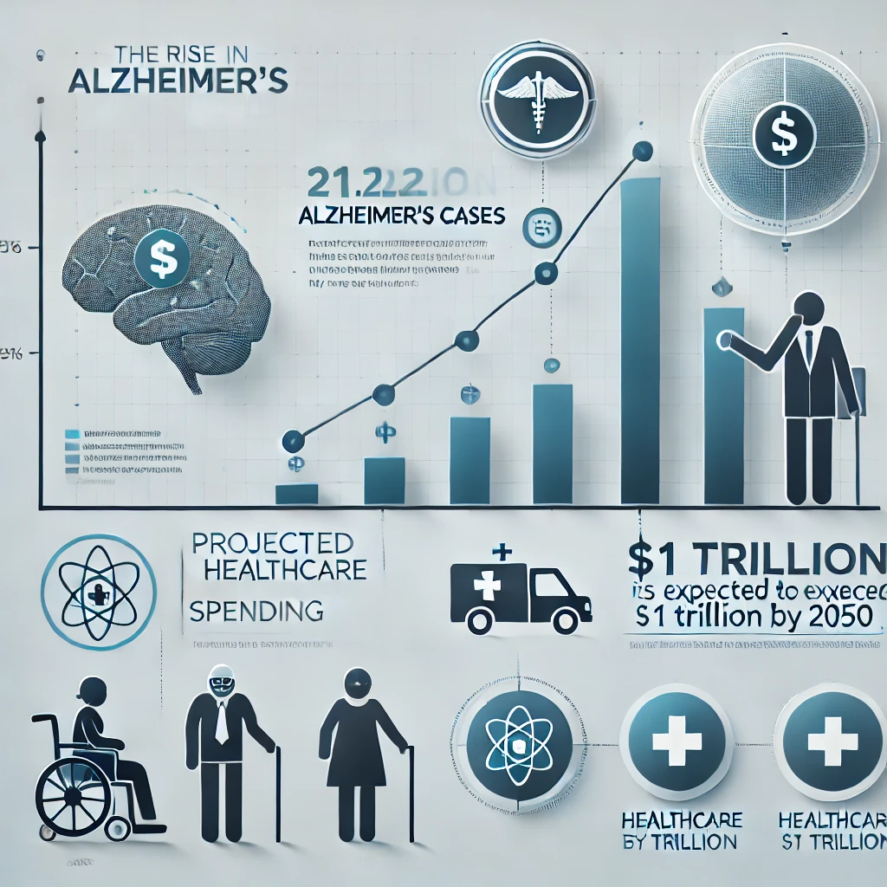
MARKET NEED
Alzheimer's disease spread rate
Affects over 50 million people globally.
Strong demand for early detection and protective care.
Alzheimer's disease spread rate
Global spending on Alzheimer’s is projected to surpass $1 trillion by 2050.
Need for solutions to reduce costs.

Slide 4
MARKET NEED
Technological Advancements:
AI, machine learning, and big data are transforming healthcare.
Predictive models identifying Alzheimer’s risk factors can enable personalized care and better outcomes.
Why Now?
Urgent need for innovative, data solutions to improve early diagnosis and prevention.

Slide 5
Selling Points
01 - Unique Value Proposition (USP)
Provides predictive insights for early Alzheimer's detection.
Empowers data-driven decisions for targeted treatments and personalized care.
02 - Key Features
Data Visualization
Predictive Analytics
User-Friendly
Custom Reports
03 - Target Market
Hospitals & Clinics
Pharmaceutical Companies
Research Institutions

Slide 6
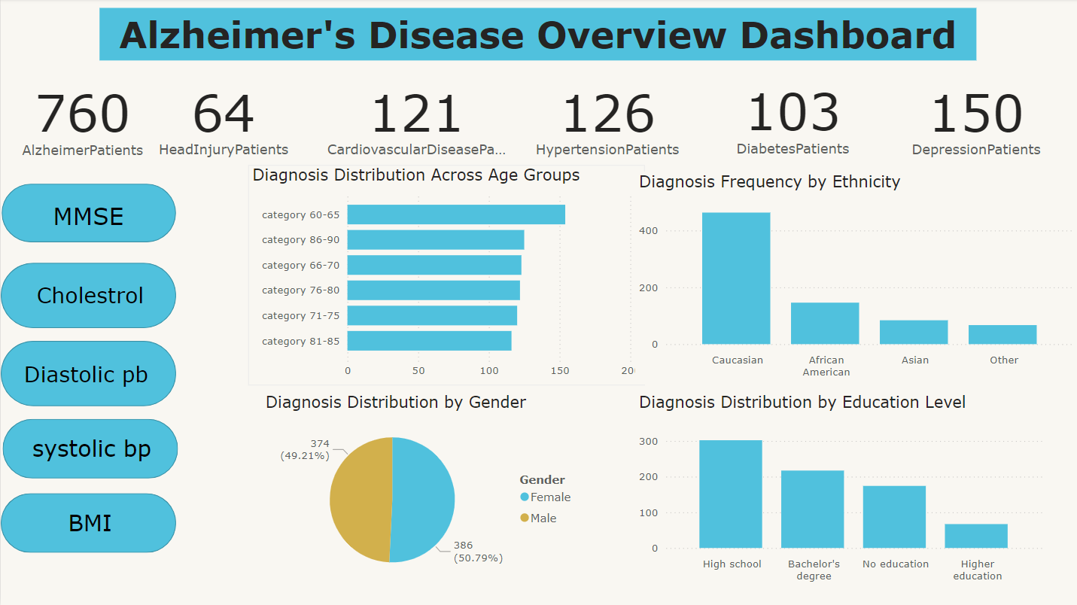
Data Visualization
01 – User-Friendly
02 - predictive insights
03 – Early diagnosis

Slide 7
Competitive Advantage
01 - Accuracy & Reliability
Identifies correlations with other diseases, offering a more comprehensive analysis.
02 - Scalability
Easily handles large datasets and can be scaled from small clinics to large hospitals.
Seamlessly integrates with existing systems, helping providers reduce costs in Alzheimer’s care.
03 - Cost-Effectiveness
Provides full support and training to healthcare teams, ensuring smooth adoption and minimal downtime.
04 - Support & Training

Slide 8
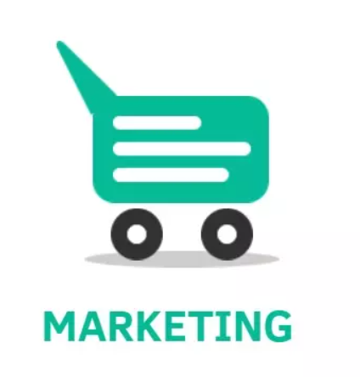
Business Strategy
Go-to-Market Strategy
Focusing on B2B partnerships with hospitals, pharmaceutical companies, and research institutions.
Building alliances with healthcare institutions for clinical practice integration.
Revenue Model:
Subscription-based model: Recurring fees for healthcare providers to access the platform.
Customization services: Tailored features for pharmaceutical companies and research institutions.

Slide 9

Business Strategy
Marketing Channels:
Direct sales (B2B outreach) and content marketing (case studies, research publications).
Hosting webinars and attend healthcare conferences to demonstrate product capabilities.
Creating whitepapers and research reports to establish thought leadership in Alzheimer’s care.

Slide 10


Call-to-action
Join Us in Revolutionizing Alzheimer’s Care
Partner with Us to bring data-driven insights to healthcare providers and improve early detection and treatment of Alzheimer’s.
Explore Our Solution: Schedule a demo or pilot program to see the impact of our predictive analytics tool in action.
Collaborate: Let’s work together with hospitals, research institutions, and pharmaceutical companies to enhance patient care and reduce costs.

Slide 11
THANK YOU

